Slide 1


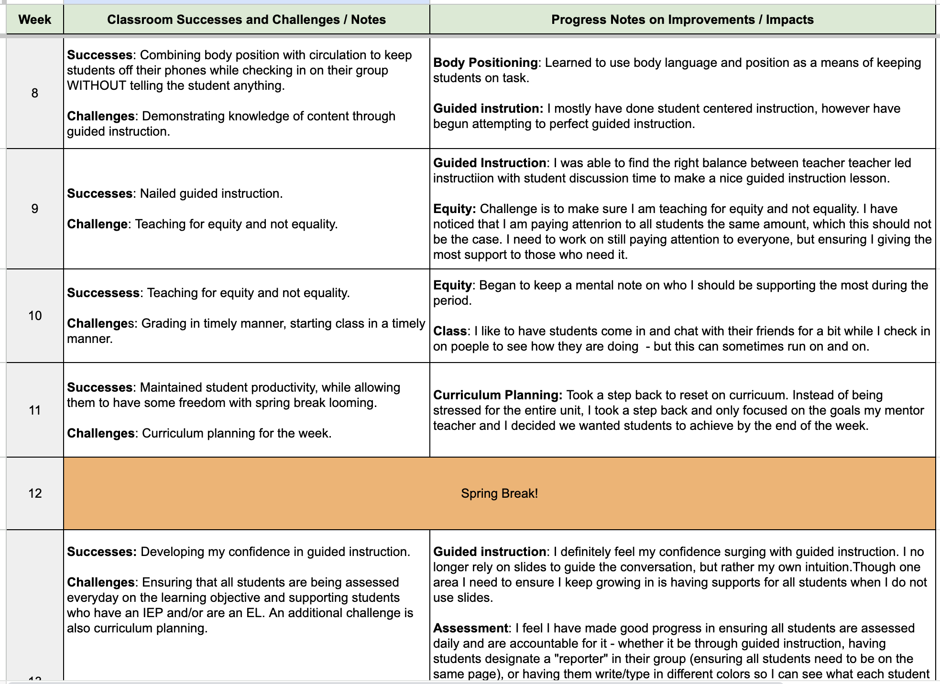
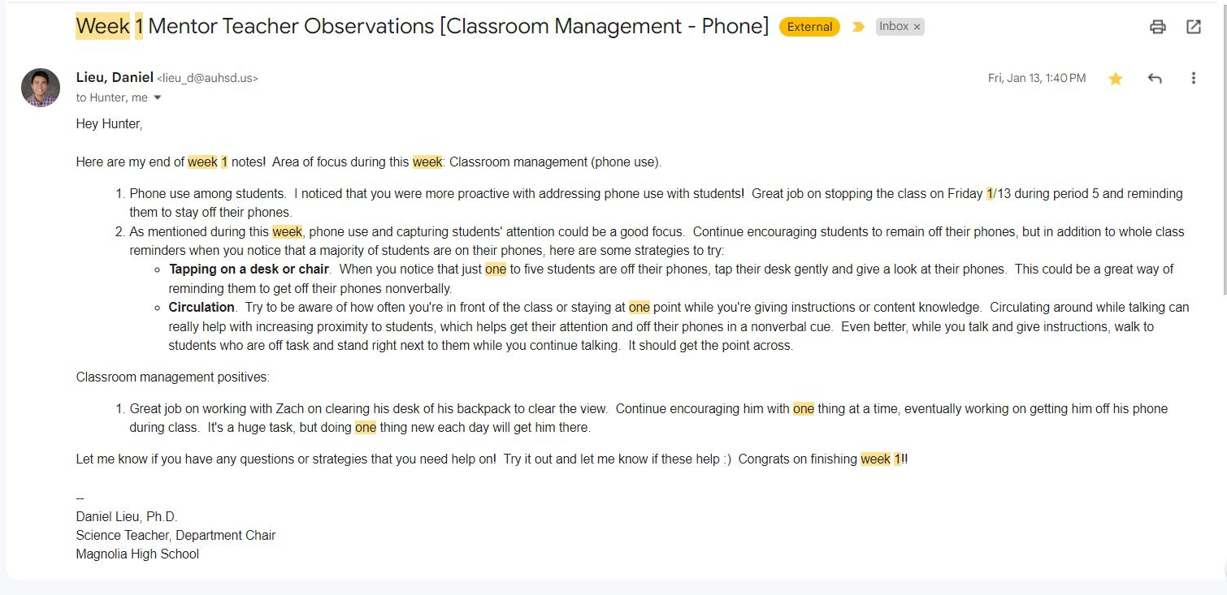
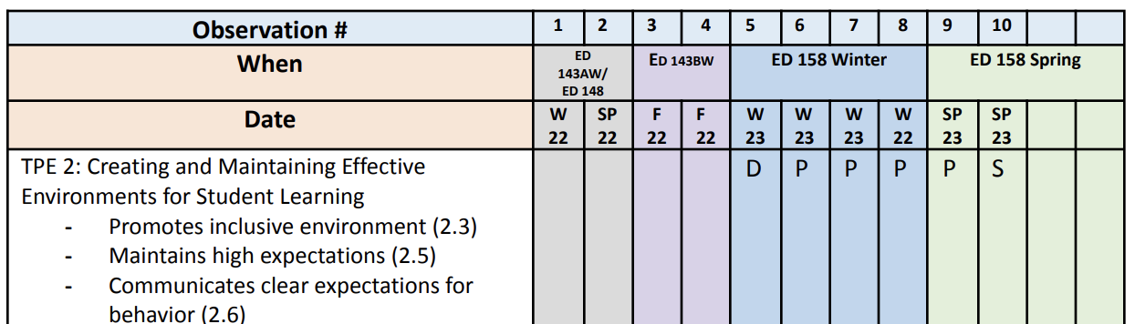
Reflective feedback tracker for teacher Growth
Daniel Lieu, Ph.D. and Hunter Rojas
“We do not learn from experience. We learn from reflecting on experience.” – John Dewey
Intent
Impact
Implication
Summary
conclusion
The intent of this reflective tracker was to encourage Hunter, as a student teacher, to actively reflect on his own teaching practices week by week. The reflective tracker encouraged Hunter to think deeper about the practices that he was engaging with inside the classroom by analyzing his strengths and areas of growth. Daniel, mentor teacher, supported Hunter’s reflection through focused observations.
This is a great tool for mentor teachers to adapt. Because of this tool, Hunter acquired one of the most important skills as an educator -- reflection. Without this tool, he felt that he would have been struggling more as a teacher and with his own teaching identity. If Hunter were to give this to his own student teacher, he would ask his student teacher to write down a positive memory from the week that they would want to look back on. It helped him develop his teaching style, core philosophy, and have a clear feedback system and tracker for the edTPA, future jobs, and documentation of growth. Without a clear reflection system, teaching practices that sustain the status quo, are outdated, and/or unintentionally leading to inequity in the classroom will continue to be implemented.
Weekly Summary Email
The Planning Calendar
The teaching performance expectations (TPE) tracker demonstrates Hunter’s growth over time after evaluation by his supervisor. Hunter attributed his TPE growth to the progress tracker, which helped him intentionally reflect on his practices with a clear focus area each time.
Identify
Teach & Learn
Reflect & Plan
Feedback Method
MON | TUE | WED | THU | FRI | SAT | SUN
 | 1 | 2 | 3 | 4 | 5 | 6
7 | 8 | 9 | 10 | 11 | 12 | 13
14 | 15 | 16 | 17 | 18 | 19 | 20
21 | 22 | 23 | 24 | 25 | 26 | 27
28 | 29 | 30 | 31
The Impact Cycle (Knight, 2018)
Identify
Learn
Improve
01
We identified areas of need at the beginning of each week. This was framed around the CalTeach core dispositions (Humanizing & equity-focused instruction, instructional innovation, and reflective learning.)
02
Daniel observed while Hunter taught, looking for strengths and areas of growths centered, specifically gathering data to frame conversation. We learned – from others, research articles, and developed an intentional plan. Document above to track growth.
03
Intentional feedback that had specific next steps and intended outcomes was listed. Hunter continued to reflect and refine his teaching practices through successes and challenges, as well as determining future growth goals. The cycle repeats.
Contact info
Daniel Lieu, Ph.D.
Dept. Chair, Teacher
lieu_d@auhsd.us
Hunter Rojas
Student Teacher
hvrojas@uci.edu

